Slide 1
Intro To Express and Modules
Week 5

Slide 2
What is Express?
- A web application framework
- Build back-end server/api
- MEAN Stack (Mongo, Express, Angular JS, Node)

Slide 3
What is Express?
- A web application framework
- Build back-end server/api
- MEAN Stack (Mongo, Express, Angular JS, Node)
- How do we create an express server?

Slide 4
Creating your first express server
Create a folder (our server code will live in this folder)
Run npm init (Allows us to use node modules and run our server in the terminal)
Install the express node module `npm install express`

Slide 5
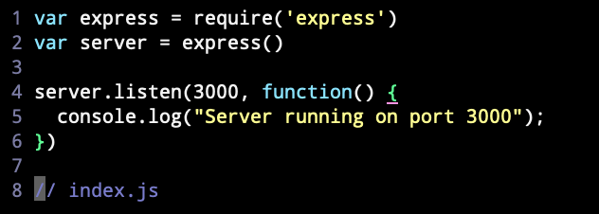
Creating your first express server
4) Create a `name_of_server`.js file
5) Require the express node module `var express = require(`express`)
6) Initialize the express module `var server = express()`
7) Have the server listen on a port

Slide 6
Creating your first express server
Yay! Our server is up and running. But it doesn’t do anything yet…
Your server is now listening on localhost:3000, but we haven’t told it what to listen for.
Let’s defines some ENDPOINTS.

Slide 7
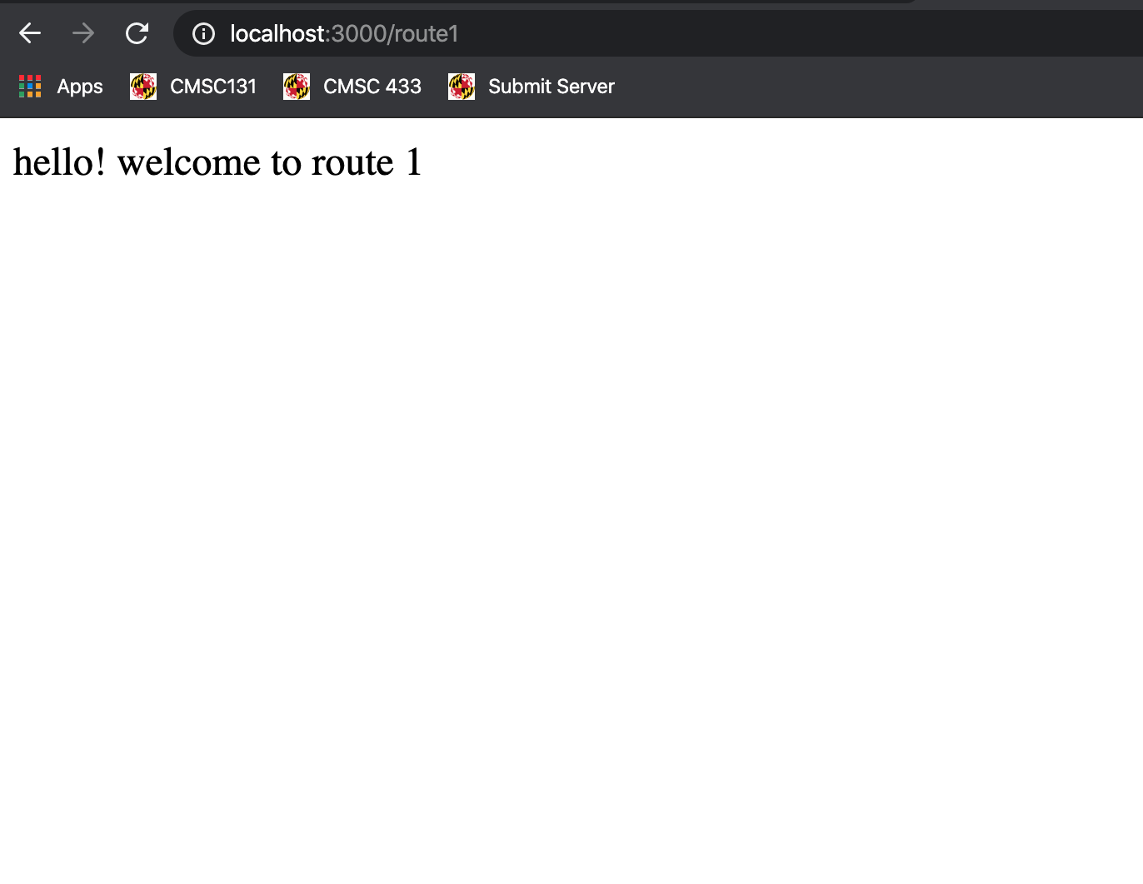

Get Endpoints and Get Requests
When we type in this URL we are actually making a GET request to our server at this specific ROUTE
HOST
REQUEST
Path (endpoint)

Slide 8
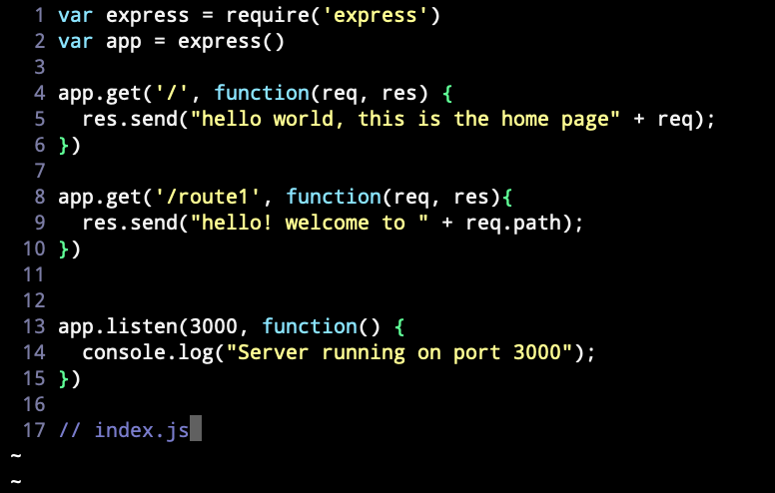
Get Endpoints and Get Requests
REQUEST
Path (endpoint)

Slide 9
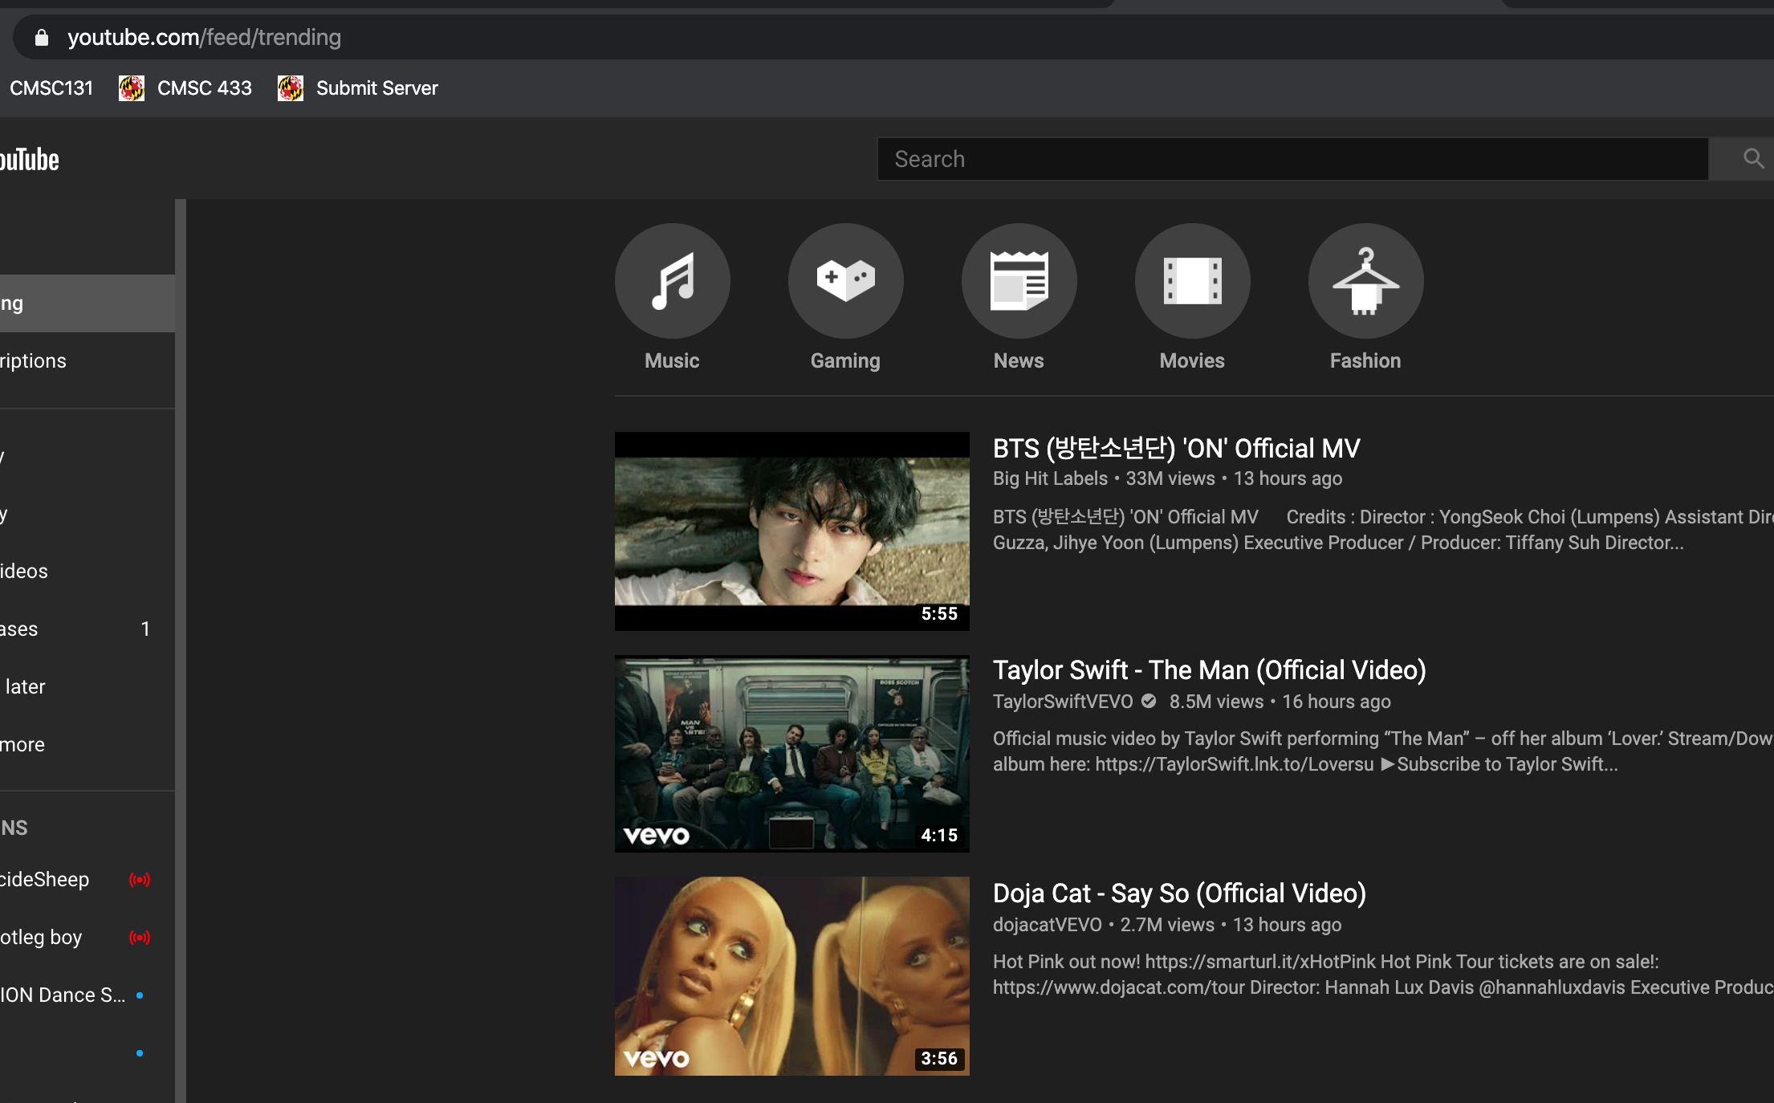

Youtube Example
HOST
REQUEST
Path (endpoint)

Slide 10
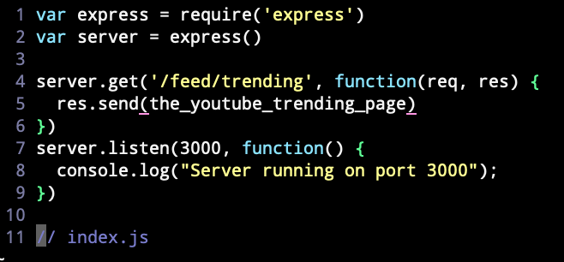
Youtube Example

Slide 11
Questions so far?
Week 5

Slide 12
Modules!
Week 5

Slide 13
What are modules?
Creating modules are a way to isolate our code in to “packages”
We can then use these packages/modules in other areas of our code
This allows us to make code cleaner and more reusable in javascript
For example: If we wanted to create some functions that will be used in multiple areas of project, we might think to put those function in a module. This way we can use the module wherever we want.
How do we create a module?
Simply create a javascript file -> `name_of_module.js`
Export the functions in the javascript file

Slide 14
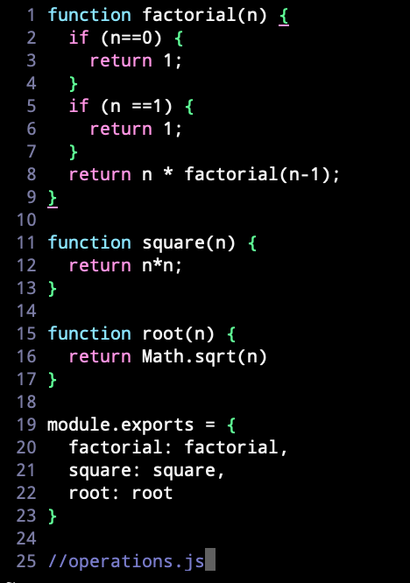
Our Operations Module

Slide 15
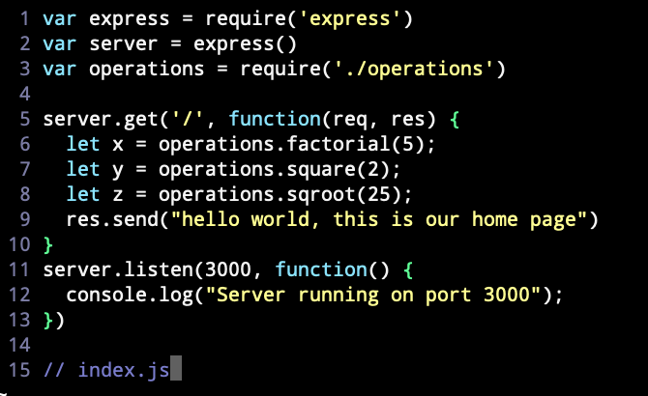
Using our Operations module in our server!
Our operations module
Using our operations module elsewhere

Slide 16
Questions On Modules?
Week 5

Slide 17
Back to The Server
Week 5

Slide 18

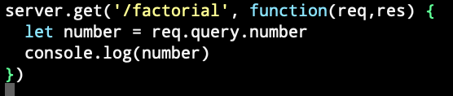
Query parameters
Request
path (factorial)
query (?number=50)
number

Slide 19
Creating endpoints that are tailored to our Operations Module
Let’s create the following endpoints
.get(`/factorial`, function(req,res){})
.get(‘/sqroot`, function(req,res){}))
.get(‘/square’, function(req,res){}))
Idea: When the user makes a request to the following endpoints, our server utilizes the corresponding function in our operations module. The server will also use query parameters to put a number in the corresponding operation.

Slide 20
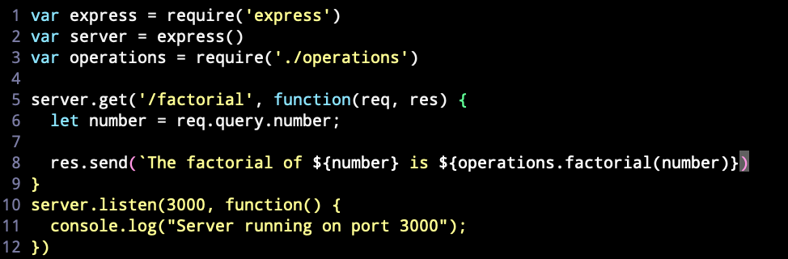
The logic of our get requests

Slide 21
Simplifying our Server code with Route Parameters
Instead of having three separate GET endpoints for each of our operation functions, let’s have ONE GET endpoint that can handle ALL operation functions.
How to achieve: Use Route Parameters

Slide 22

Route Parameters
Route parameters act as “placeholders”
They live in the request and capture whatever text is sitting in the spot of the “placeholder”
We denote a route parameter with a colon followed by the name of the route parameter

Slide 23

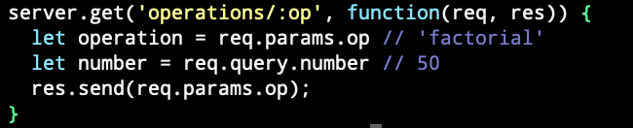
Route Parameters
Request
path (factorial)
query (?number=50)
Number
params
op (‘factorial’)

Slide 24
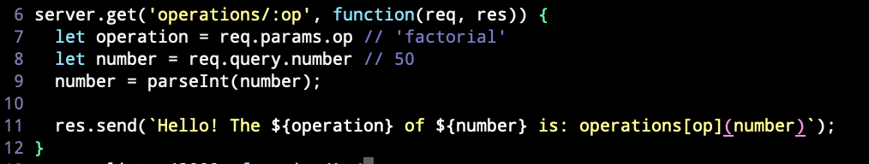
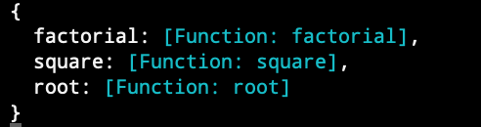
Putting it together
Operations is a javascript object! So, for example, calling operations[‘factorial’] returns the factorial function

Slide 25
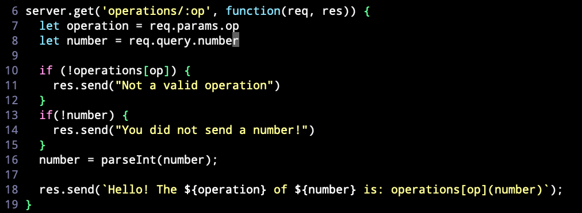
Adding some error handling

